Slide 1

Relational Data Model and
Relational Algebra
Chapter 3 (Cont)

Slide 2
Contents
1 | Unary Relational Operations
2 | Relational Algebra Operations from Set Theory
3 | Binary Relational Operations
4 | Additional Relational Operations
5 | Brief Introduction to Relational Calculus

Slide 3
Contents
1 | Unary Relational Operations
2 | Relational Algebra Operations from Set Theory
3 | Binary Relational Operations
4 | Additional Relational Operations
5 | Brief Introduction to Relational Calculus

Slide 4
Relational Algebra Overview
Relational algebra is the basic set of operations for the relational model.
  These operations enable a user to specify basic retrieval requests (or queries).
The result of an operation is a new relation, which may have been formed from one or more input relations.
  This property makes the algebra “closed” (all objects in relational algebra are relations).
A sequence of relational algebra operations forms a relational algebra expression.

Slide 5
Relational Algebra Overview
Unary Relational Operations:
  SELECT (symbol: σ (sigma))
  PROJECT (symbol: π (pi))
  RENAME (symbol: ρ (rho))
Relational Algebra Operations from Set Theory:
  UNION (∪), INTERSECTION (∩), DIFFERENCE (or MINUS, –)
  CARTESIAN PRODUCT ( x )
Binary Relational Operations:
  JOIN (several variations of JOIN exist)
  DIVISION
Additional Relational Operations:
  OUTER JOINS, OUTER UNION
  AGGREGATE FUNCTIONS (SUM, COUNT, AVG, MIN, MAX)

Slide 6
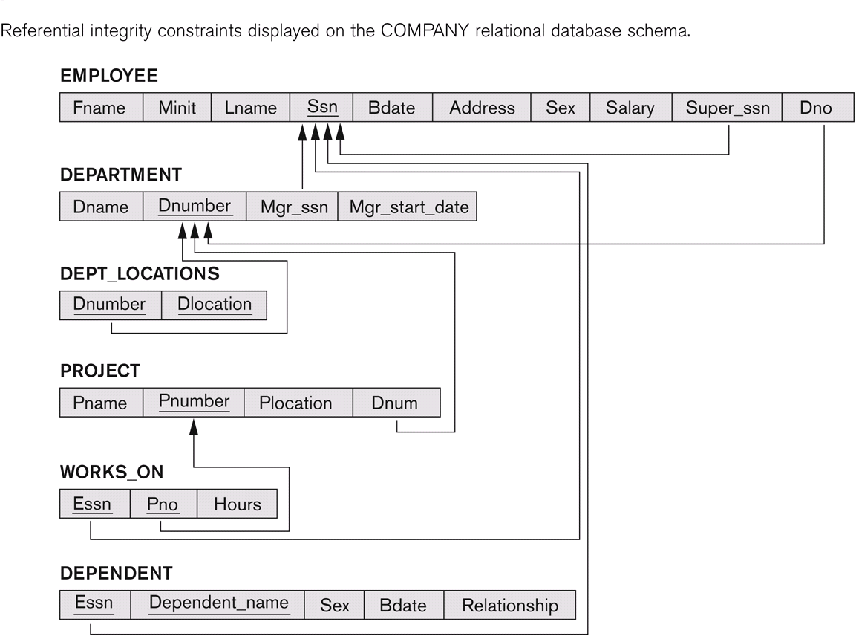
COMPANY Database Schema

Slide 7
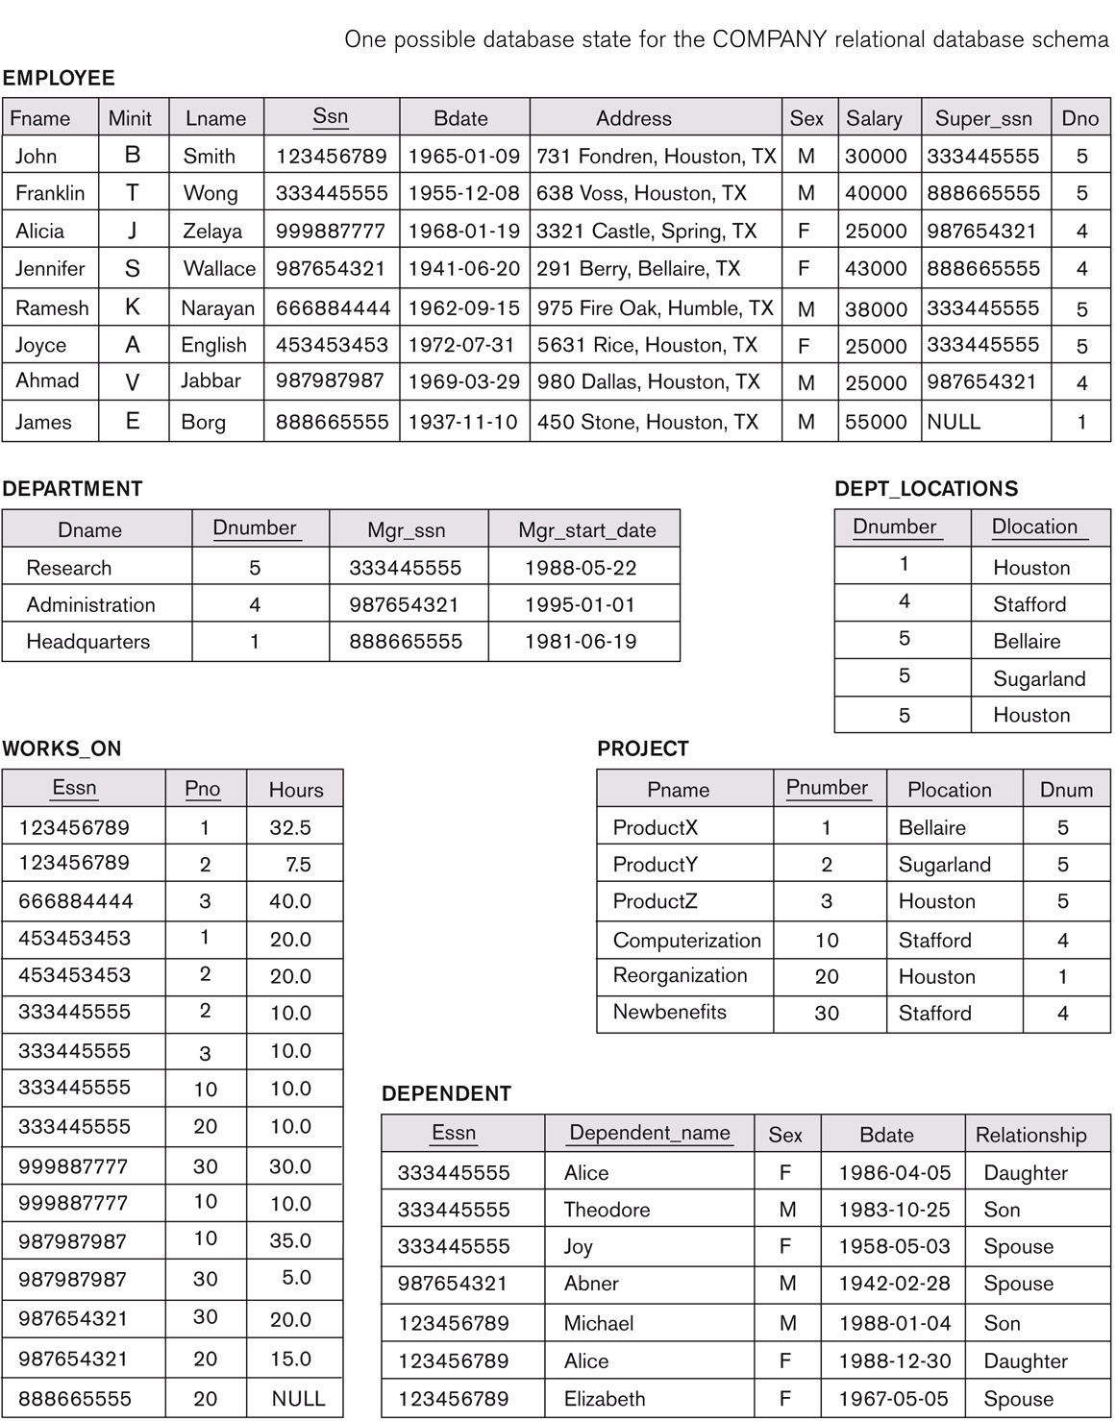
The following query results refer to this database state

Slide 8
The following query results refer to this database state

Slide 9
Unary Relational Operations: SELECT
The SELECT operation (denoted by σ (sigma)) is used to select a subset of the tuples from a relation based on a selection condition.
Examples:
  Select the EMPLOYEE tuples whose department number is 4:
σ _{DNO = 4} (EMPLOYEE)
  Select the EMPLOYEE tuples whose salary is greater than $30,000:
σ _{SALARY > 30,000} (EMPLOYEE)

Slide 10
Unary Relational Operations: SELECT
In general, the select operation is denoted by σ_{<selection condition>}(R) where:
  σ (sigma) is used to denote the select operator.
  <selection condition> is a Boolean expression specified on the attributes of relation R.
  Tuples that make the condition true appear in the result of the operation, and tuples that make the condition false are discarded from the result of the operation.

Slide 11
Unary Relational Operations: SELECT
SELECT Operation Properties
  The relation S = σ _{<selection condition>}(R) has the same schema (same attributes) as R.
  SELECT σ is commutative:
  σ_{<cond1>}(σ _{< cond2>}(R)) = σ_{<cond2>}(σ_{<cond1>}(R))
  Because of commutativity property, a cascade (sequence) of SELECT operations may be applied in any order:
    σ_{<cond1>}(σ_{<cond2>}(σ_{<cond3>}(R))
    = σ_{<cond2>}(σ_{<cond3>}(σ_{<cond1>}(R)))
    = σ_{<cond1>AND<cond2>AND<cond3>}(R)
  The number of tuples in the result of a SELECT is less than (or equal to) the number of tuples in the input relation R.

Slide 12
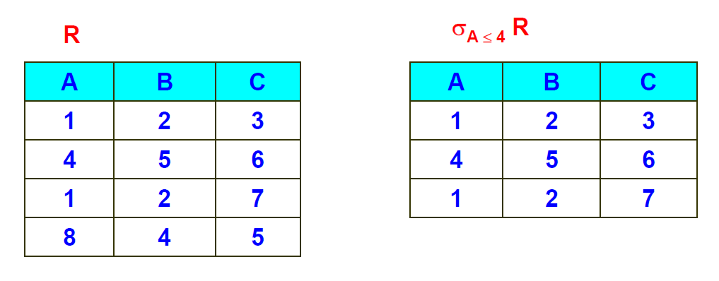
Example of SELECT operation

Slide 13
Unary Relational Operations: PROJECT
PROJECT Operation is denoted by π (pi).
This operation keeps certain columns (attributes) from a relation and discards the other columns.
  PROJECT creates a vertical partitioning: the list of specified columns (attributes) is kept in each tuple, the other attributes in each tuple are discarded.
Example: To list each employee’s first and last name and salary, the following is used:
  π_{LNAME, FNAME,SALARY}(EMPLOYEE)

Slide 14
Unary Relational Operations: PROJECT
The general form of the project operation is:
π_{<attribute list>}(R)
  <attribute list> is the desired list of attributes from relation R
The project operation removes any duplicate tuples because the result of the project operation do not allow duplicate elements.

Slide 15
Unary Relational Operations: PROJECT
PROJECT Operation Properties:
  The number of tuples in the result of projection π_{<list>}(R) is always less than or equal to the number of tuples in R.
    If the list of attributes includes a key of R, then the number of tuples in the result of PROJECT is equal to the number of tuples in R.
  PROJECT is not commutative.
  π _{<list1>} (π _{<list2>} (R) ) = π _{<list1>} (R) ?
    as long as <list2> contains the attributes in <list1>

Slide 16
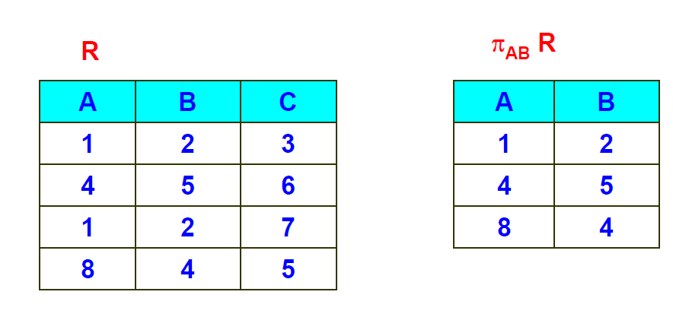
Example of PROJECT operation

Slide 17
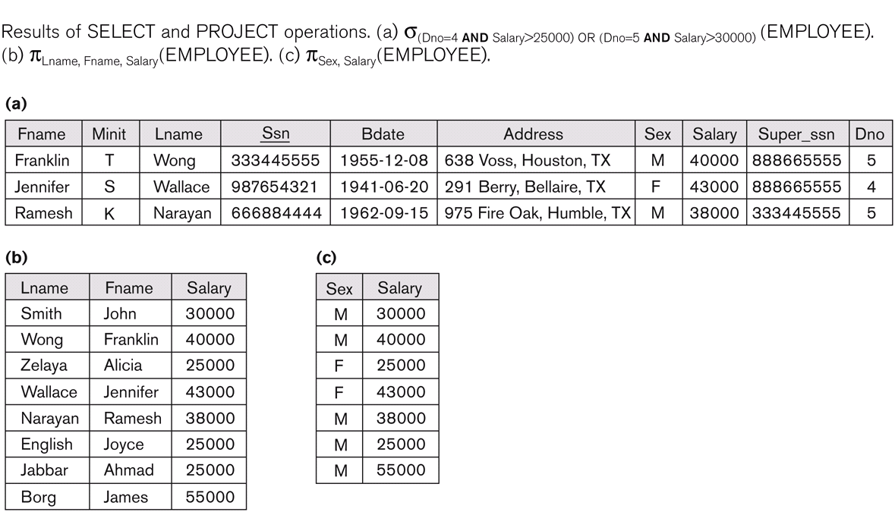
Examples of applying SELECT and PROJECT operations

Slide 18
Relational Algebra Expressions
We may want to apply several relational algebra operations one after the other.
  Either we can write the operations as a single relational algebra expression by nesting the operations, or
  We can apply one operation at a time and create intermediate result relations.
In the latter case, we must give names to the relations that hold the intermediate results.

Slide 19
Single expression versus sequence of relational operations
To retrieve the first name, last name, and salary of all employees who work in department number 5, we must apply a select and a project operation.
We can write a single relational algebra expression as follows:
  π_{FNAME, LNAME, SALARY}(σ _{DNO=5}(EMPLOYEE))
OR We can explicitly show the sequence of operations, giving a name to each intermediate relation:
  DEP5_EMPS ← σ _{DNO=5}(EMPLOYEE)
  RESULT ← π _{FNAME, LNAME, SALARY} (DEP5_EMPS)

Slide 20
Unary Relational Operations: RENAME
The RENAME operator is denoted by ρ (rho).
In some cases, we may want to rename the attributes of a relation or the relation name or both.
  Useful when a query requires multiple operations.
  Necessary in some cases (see JOIN operation later).

Slide 21
Unary Relational Operations: RENAME
The general RENAME operation ρ can be expressed by any of the following forms:
  ρ_{S (B1, B2, …, Bn )}(R) changes both:
    the relation name to S, and
    the column (attribute) names to B1, B2, …..Bn
  ρ_{S}(R) changes:
    the relation name only to S
  ρ_{(B1, B2, …, Bn )}(R) changes:
    the column (attribute) names only to B1, B2, …..Bn
  RESULT (First_Name, Last_name, Salary) ← π _{FNAME, LNAME, SALARY} (DEP5_EMPS)

Slide 22
Contents
1 | Unary Relational Operations
2 | Relational Algebra Operations from Set Theory
3 | Binary Relational Operations
4 | Additional Relational Operations
5 | Brief Introduction to Relational Calculus

Slide 23
Relational Algebra Operations from
Set Theory: UNION
Binary operation, denoted by ∪.
The result of R ∪ S, is a relation that includes all tuples that are either in R or in S or in both R and S.
Duplicate tuples are eliminated.
The two operand relations R and S must be “type compatible” (or UNION compatible):
  R and S must have same number of attributes.
  Each pair of corresponding attributes must be type compatible (have same or compatible domains).

Slide 24
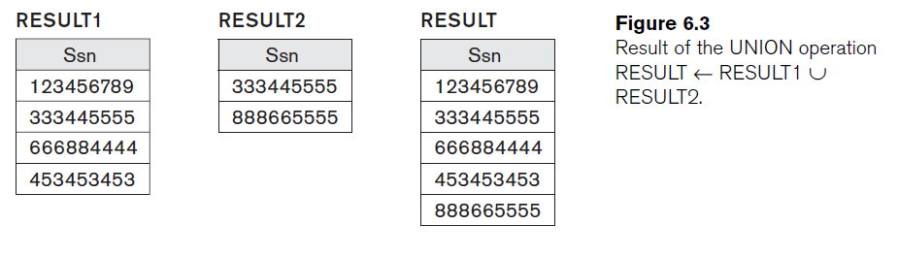
Example of the result of a UNION operation

Slide 25
Relational Algebra Operations from
Set Theory
Type Compatibility of operands is required for the binary set operation UNION ∪, (also for INTERSECTION ∩, SET DIFFERENCE –).
The resulting relation for R1∪R2 (also for R1∩R2, or R1–R2) has the same attribute names as the first operand relation R1 (by convention).

Slide 26
Relational Algebra Operations from Set Theory: INTERSECTION
INTERSECTION is denoted by ∩.
The result of the operation R ∩ S, is a relation that includes all tuples that are in both R and S.
  The attribute names in the result will be the same as the attribute names in R.
The two operand relations R and S must be “type compatible”.

Slide 27
Relational Algebra Operations from Set Theory: SET DIFFERENCE
SET DIFFERENCE (also called MINUS or EXCEPT) is denoted by –.
The result of R – S, is a relation that includes all tuples that are in R but not in S.
  The attribute names in the result will be the same as the attribute names in R.
The two operand relations R and S must be “type compatible”.

Slide 28
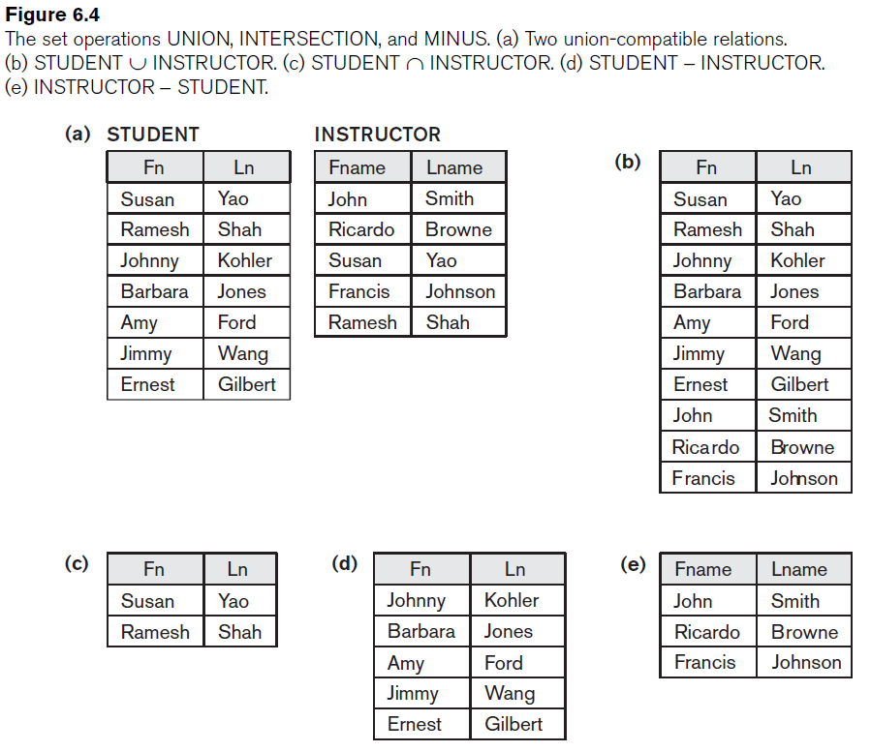
Example to illustrate the result of UNION, INTERSECT, DIFFERENCE

Slide 29
Some properties of UNION, INTERSECT, and DIFFERENCE
Notice that both union and intersection are commutative operations; that is:
  R ∪ S = S ∪ R, and R ∩ S = S ∩ R
Both union and intersection can be treated as n-ary operations applicable to any number of relations because both are associative operations:
  R ∪ (S ∪ T) = (R ∪ S) ∪ T
  (R ∩ S) ∩ T = R ∩ (S ∩ T)
The minus operation is not commutative; that is, in general
  R – S ≠ S – R

Slide 30
Relational Algebra Operations from Set Theory: CARTESIAN PRODUCT
CARTESIAN (or CROSS) PRODUCT Operation
  Denoted by R(A1, A2, ..., An) x S(B1, B2, ..., Bm)
  Result is a relation with degree n + m attributes:
    Q(A1, A2, ..., An, B1, B2, ..., Bm), in that order.
  The resulting relation Q has one tuple for each combination of tuples—one from R and one from S.
  If R has n_{R} tuples (denoted as |R| = n_{R} ), and S has n_{S} tuples, then R x S will have n_{R} * n_{S} tuples.
  The two operands do NOT have to be "type compatible”.

Slide 31
FULLNAME_LIST ← FIRSTNAME_LIST x LASTNAME_LIST

Slide 32
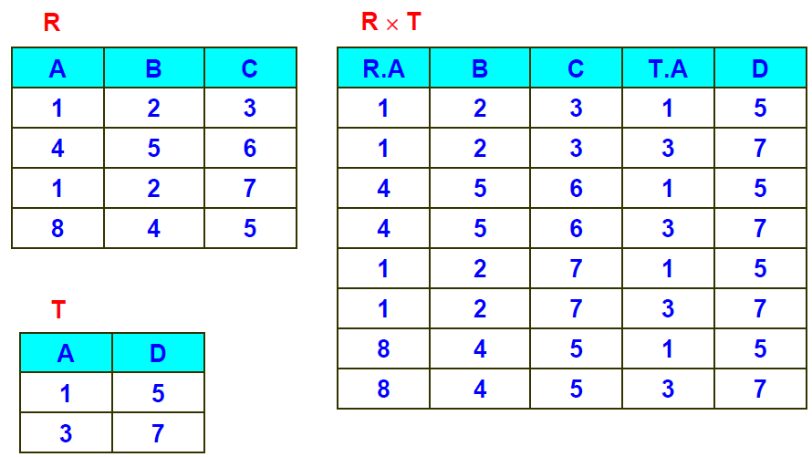
Example of CARTESIAN PRODUCT operation

Slide 33
Contents
1 | Unary Relational Operations
2 | Relational Algebra Operations from Set Theory
3 | Binary Relational Operations
4 | Additional Relational Operations
5 | Brief Introduction to Relational Calculus

Slide 34
Binary Relational Operations: JOIN
JOIN Operation (denoted by )
  The sequence of CARTESIAN PRODUCT followed by SELECT is used quite commonly to identify and select related tuples from two relations.
  A special operation, called JOIN combines this sequence into a single operation.
  This operation is very important for any relational database with more than a single relation, because it allows us combine related tuples from various relations.

Slide 35
Binary Relational Operations: JOIN
JOIN Operation (denoted by )
  The general form of a join operation on two relations R(A1, A2, . . ., An) and S(B1, B2, . . ., Bm) is:
  R _{<join condition>}S
    where R and S can be any relations that result from general relational algebra expressions.

Slide 36
Binary Relational Operations: JOIN
Example: Suppose that we want to retrieve the name of the manager of each department.
  To get the manager’s name, we need to combine each DEPARTMENT tuple with the EMPLOYEE tuple whose SSN value matches the MGRSSN value in the department tuple.
  DEPT_MGR←DEPARTMENT _{MGRSSN=SSN}EMPLOYEE
MGRSSN = SSN is the join condition.
  Combines each department record with the employee who manages the department.
  The join condition can also be specified as: DEPARTMENT.MGRSSN= EMPLOYEE.SSN

Slide 37
COMPANY Database Schema

Slide 38
The following query results refer to this database state

Slide 39
The following query results refer to this database state

Slide 40
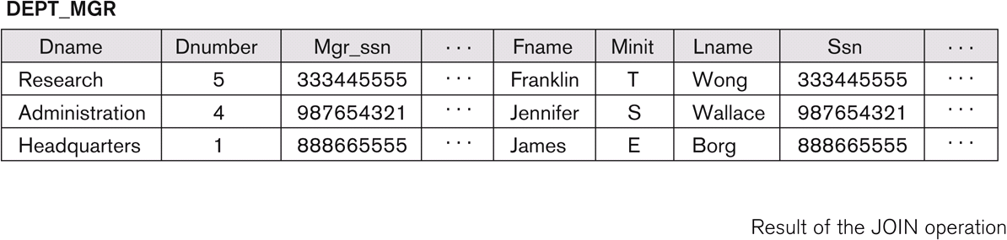
Example of applying the JOIN operation
DEPT_MGR ← DEPARTMENT _{MGRSSN=SSN} EMPLOYEE

Slide 41
Some properties of JOIN
Consider the following JOIN operation:
  R(A1, A2, . . ., An) S(B1, B2, . . ., Bm)
    R.Ai=S.Bj
  Result is a relation Q with degree n + m attributes:
    Q(A1, A2, . . ., An, B1, B2, . . ., Bm), in that order
  The resulting relation state has one tuple for each combination of tuples - r from R and s from S, but only if they satisfy the join condition r[Ai]=s[Bj].
  Hence, if R has n_{R} tuples, and S has n_{S} tuples, then the join result will generally have less than n_{R} * n_{S} tuples.
  Only related tuples (based on the join condition) will appear in the result.

Slide 42
Some properties of JOIN
The general case of JOIN operation is called a Theta-join: R _{<theta>} S
The join condition is called theta.
>, < , =, …
Theta can be any general boolean expression on the attributes of R and S; for example:
  R.Ai < S.Bj AND (R.Ak = S.Bl OR R.Ap < S.Bq)

Slide 43
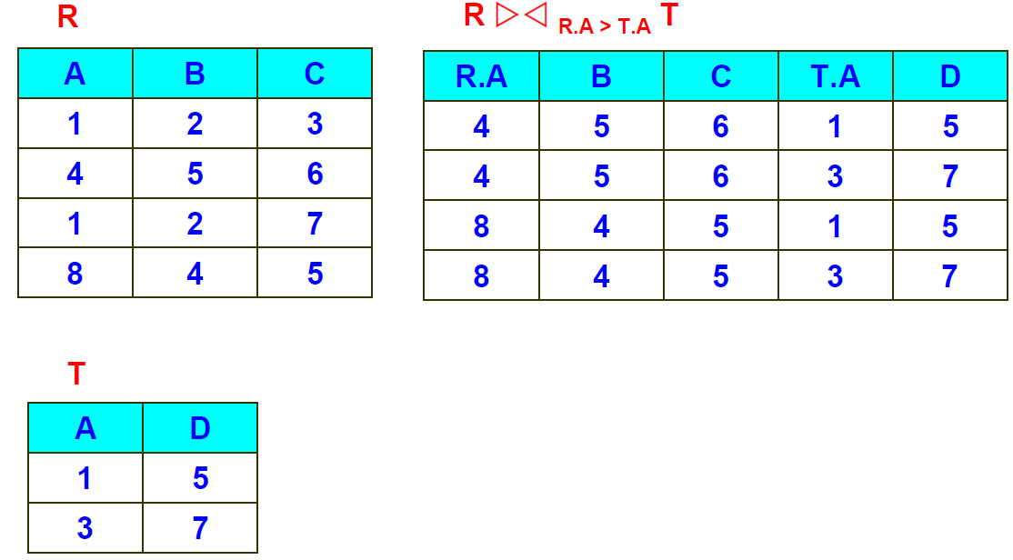
Example of JOIN operation

Slide 44
Binary Relational Operations: EQUIJOIN
A join, where the only comparison operator used is =, is called an EQUIJOIN.
  In the result of an EQUIJOIN we always have one or more pairs of attributes (whose names need not be identical) that have identical values in every tuple.

Slide 45
Binary Relational Operations:
NATURAL JOIN Operation
NATURAL JOIN Operation
  Another variation of JOIN called NATURAL JOIN, denoted by *, was created to get rid of the second (superfluous) attribute in an EQUIJOIN condition.
  The standard definition of natural join requires that the two join attributes, or each pair of corresponding join attributes, have the same name in both relations.
  If this is not the case, a renaming operation is applied first.
Example: Q ← R(A,B,C,D) * S(C,D,E)
  The implicit join condition includes each pair of attributes with the same name, “AND” ed together: R.C = S.C AND R.D = S.D
  Result keeps only one attribute of each such pair:
    Q(A,B,C,D,E)

Slide 46
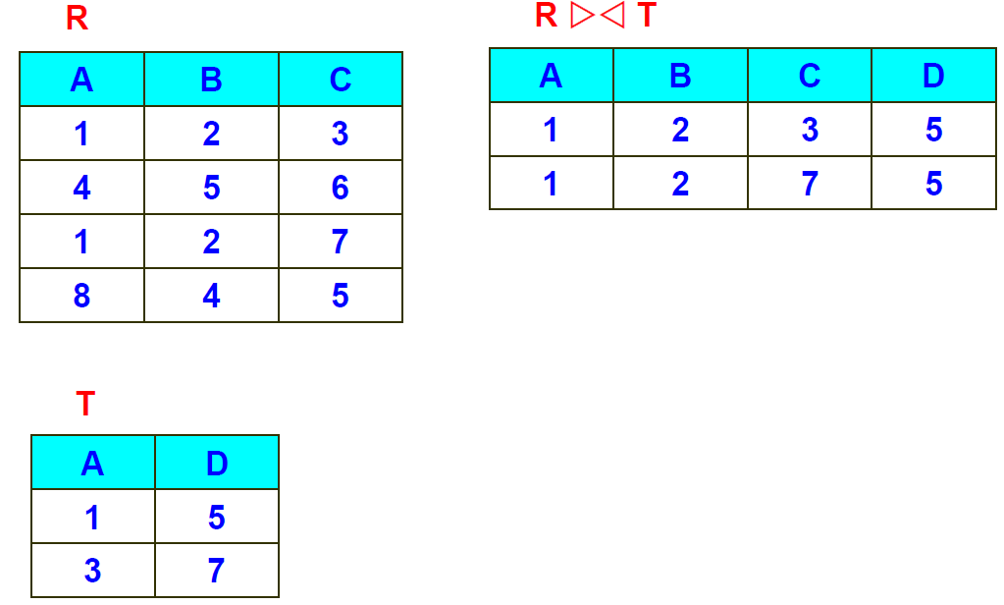
Example of NATURAL JOIN operation
*

Slide 47
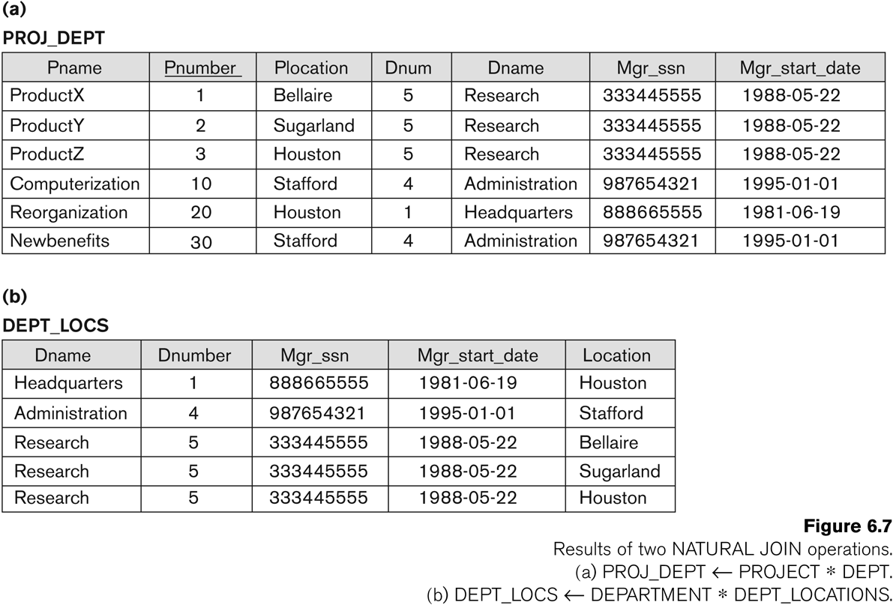

Example of NATURAL JOIN operation

Slide 48
Complete Set of Relational Operations
The set of operations {σ, π , ∪, - , X} is called a complete set because any other relational algebra expressions can be expressed by a combination of these five operations.
For example:
  R ∩ S = (R ∪ S ) – ((R − S) ∪ (S − R))
  R _{<join condition>}S = σ _{<join condition>} (R X S)

Slide 49
Binary Relational Operations: DIVISION
DIVISION Operation
  The division operation is applied to two relations
  T(Y) ← R(Z) ÷ S(X), where Y = Z − X (Y is the set of attributes of R that are not attributes of S) AND Z = X ∪ Y
  The result of DIVISION is a relation T(Y) that includes a tuple t if tuples t_{R} appear in R with t_{R} [Y] = t, and with
  t_{R} [X] = t_{s} for every tuple t_{s} in S, i.e., for a tuple t to appear in the result T of the DIVISION, the values in t must appear in R in combination with every tuple in S.

Slide 50
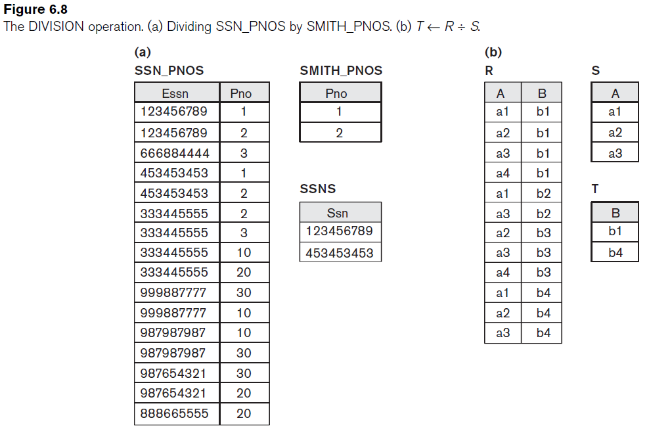

Example of the DIVISION operation
SSNS(SSN) ← SSN_PNOS $÷$ SMITH_PNOS

Slide 51
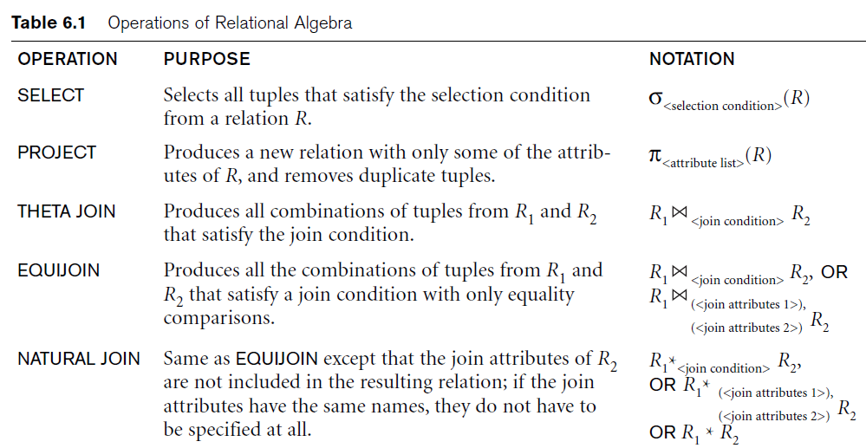
Operations of Relational Algebra

Slide 52
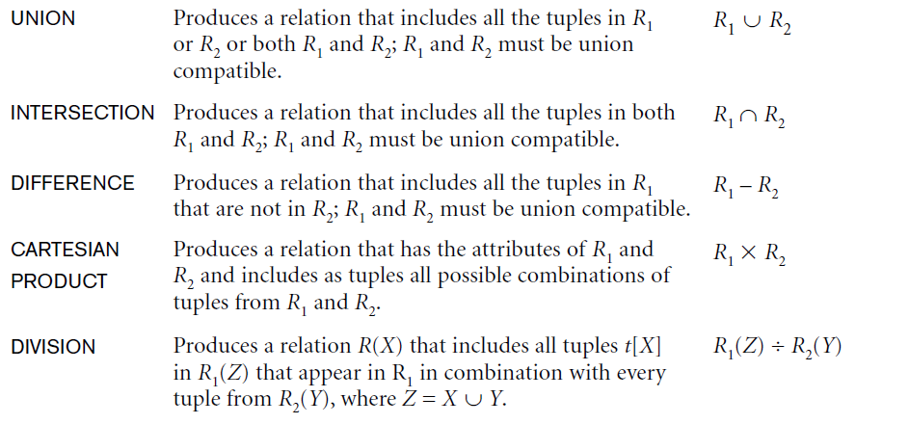
Operations of Relational Algebra

Slide 53
Notation for Query Trees
Query tree
  Represents the input relations of query as leaf nodes of the tree.
  Represents the relational algebra operations as internal nodes.

Slide 54
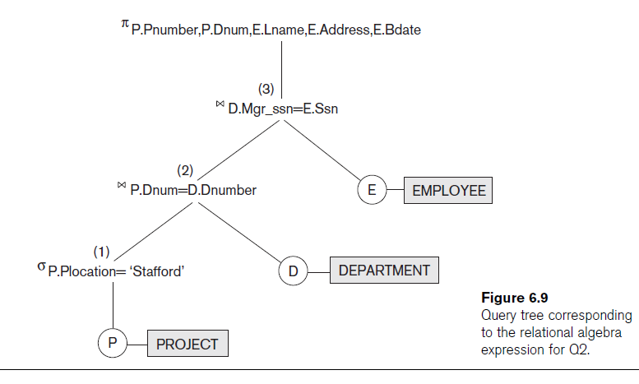

Slide 55
Contents
1 | Unary Relational Operations
2 | Relational Algebra Operations from Set Theory
3 | Binary Relational Operations
4 | Additional Relational Operations
5 | Brief Introduction to Relational Calculus

Slide 56
Additional Relational Operations
Aggregate Functions and Grouping
  A type of request that cannot be expressed in the basic relational algebra is to specify mathematical aggregate functions on collections of values from the database.
  Examples of such functions include retrieving the average or total salary of all employees or the total number of employee tuples.
  Common functions applied to collections of numeric values include SUM, AVERAGE, MAXIMUM, and MINIMUM. The COUNT function is used for counting tuples or values.

Slide 57
Additional Relational Operations
Use of the Functional operator ℱ
  ℱ_{MAX Salary} (Employee) retrieves the maximum salary value from the Employee relation
  ℱ_{MIN Salary} (Employee) retrieves the minimum Salary value from the Employee relation
  ℱ_{SUM Salary} (Employee) retrieves the sum of the Salary from the Employee relation
  _{DNO} ℱ_{COUNT SSN, AVERAGE Salary} (Employee) groups employees by DNO (department number) and computes the count of employees and average salary per department.
  Note: count just counts the number of rows, without removing duplicates.

Slide 58
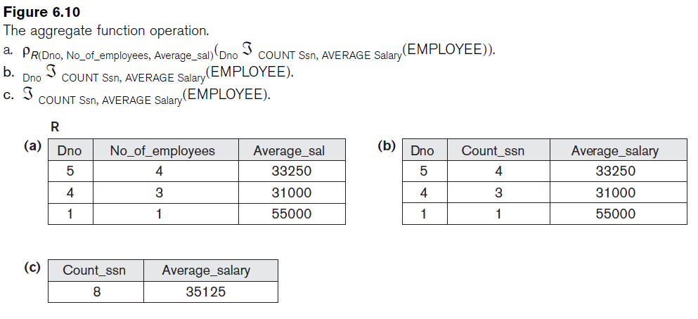
Examples of applying aggregate functions and grouping

Slide 59
Additional Relational Operations
Recursive Closure Operations
  Another type of operation that, in general, cannot be specified in the basic original relational algebra is recursive closure. This operation is applied to a recursive relationship.
  An example of a recursive operation is to retrieve all SUPERVISEES of an EMPLOYEE e at all levels.
  Although it is possible to retrieve employees at each level and then take their union, we cannot, in general, specify a query such as “retrieve the supervisees of ‘James Borg’ at all levels” without utilizing a looping mechanism.
  The SQL3 standard includes syntax for recursive closure.

Slide 60
Additional Relational Operations
The OUTER JOIN Operation
  In NATURAL JOIN and EQUIJOIN, tuples without a matching (or related) tuple are eliminated from the join result.
    Tuples with null in the join attributes are also eliminated.
    This amounts to loss of information.
  A set of operations, called OUTER joins, can be used when we want to keep all the tuples in R, or all those in S, or all those in both relations in the result of the join, regardless of whether or not they have matching tuples in the other relation.

Slide 61
Additional Relational Operations
The left outer join operation keeps every tuple in the first or left relation R in R S; if no matching tuple is found in S, then the attributes of S in the join result are filled or “padded” with null values.
A similar operation, right outer join, keeps every tuple in the second or right relation S in the result of R S; ; if no matching tuple is found in R, then the attributes of R in the join result are filled or “padded” with null values.
A third operation, full outer join, denoted by keeps all tuples in both the left and the right relations when no matching tuples are found, padding them with null values as needed.

Slide 62
The following query results refer to this database state

Slide 63

Additional Relational Operations
Example: List all employee names and also the name of the departments they manage if they happen to manage a department (if they do not manage one, we can indicate it with a NULL value)

Slide 64
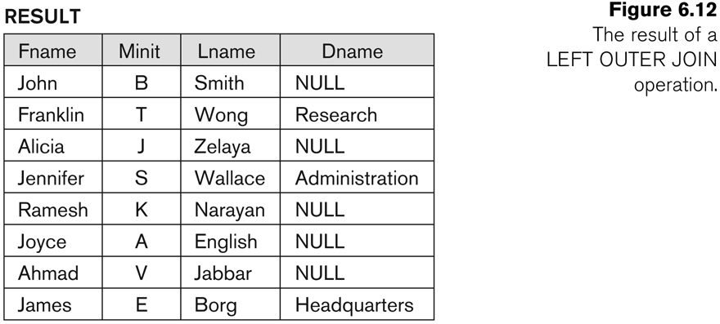
Additional Relational Operations

Slide 65
Example of LEFT OUTER JOIN
R
R S
R.A = S.P
A | B | C
1 | 2 | 3
4 | 5 | 6
1 | 2 | 7
8 | 4 | 5
A | B | C | P | Q
1 | 2 | 3 | 1 | 5
1 | 2 | 7 | 1 | 5
4 | 5 | 6 | null | null
8 | 4 | 5 | null | null
S
P | Q
1 | 5
3 | 7

Slide 66
Example of RIGHT OUTER JOIN
R
R S
R.A = S.P
A | B | C
1 | 2 | 3
4 | 5 | 6
1 | 2 | 7
8 | 4 | 5
A | B | C | P | Q
1 | 2 | 3 | 1 | 5
1 | 2 | 7 | 1 | 5
null | null | null | 3 | 7
S
P | Q
1 | 5
3 | 7

Slide 67
Example of FULL OUTER JOIN
R
R S
R.A = S.P
A | B | C
1 | 2 | 3
4 | 5 | 6
1 | 2 | 7
8 | 4 | 5
A | B | C | P | Q
1 | 2 | 3 | 1 | 5
1 | 2 | 7 | 1 | 5
4 | 5 | 6 | null | null
8 | 4 | 5 | null | null
null | null | null | 3 | 7
S
P | Q
1 | 5
3 | 7

Slide 68
Contents
1 | Unary Relational Operations
2 | Relational Algebra Operations from Set Theory
3 | Binary Relational Operations
4 | Additional Relational Operations
5 | Brief Introduction to Relational Calculus

Slide 69
Brief Introduction to Relational Calculus
A relational calculus expression creates a new relation, which is specified in terms of variables that range over rows of the stored database relations (in tuple calculus) or over columns of the stored relations (in domain calculus).
In a calculus expression, there is no order of operations to specify how to retrieve the query result—a calculus expression specifies only what information the result should contain. This is the main distinguishing feature between relational algebra and relational calculus.
Relational calculus is considered to be a nonprocedural language. This differs from relational algebra, where we must write a sequence of operations to specify a retrieval request; hence relational algebra can be considered as a procedural way of stating a query.

Slide 70
Brief Introduction to Relational Calculus
The tuple relational calculus is based on specifying a number of tuple variables. Each tuple variable usually ranges over a particular database relation, meaning that the variable may take as its value any individual tuple from that relation.
A simple tuple relational calculus query is of the form {t | COND(t)} where t is a tuple variable and COND (t) is a conditional expression involving t.
  Example: To find the first and last names of all employees whose salary is above $50,000, we can write the following tuple calculus expression:
{t.FNAME, t.LNAME | EMPLOYEE(t) AND t.SALARY>50000}
  The condition EMPLOYEE(t) specifies that the range relation of tuple variable t is EMPLOYEE. The first and last name (π_{FNAME, LNAME}) of each EMPLOYEE tuple t that satisfies the condition t.SALARY>50000 (σ _{SALARY >50000}) will be retrieved.

Slide 71
Brief Introduction to Relational Calculus
Two special symbols called quantifiers can appear in formulas; these are the universal quantifier (∀) and the existential quantifier (∃).
Informally, a tuple variable t is bound if it is quantified, meaning that it appears in an (∀ t) or (∃ t) clause; otherwise, it is free.

Slide 72
Brief Introduction to Relational Calculus
Another variation of relational calculus called the domain relational calculus, or simply, domain calculus is equivalent to tuple calculus and to relational algebra.
QBE (Query-By-Example): see Appendix D
Domain calculus differs from tuple calculus in the type of variables used in formulas: rather than having variables range over tuples, the variables range over single values from domains of attributes. To form a relation of degree n for a query result, we must have n of these domain variables - one for each attribute.
An expression of the domain calculus is of the form
{x1, x2, . . ., xn | COND(x1, x2, . . ., xn, xn+1, xn+2, . . ., xn+m)}, where:
  x1, x2, . . ., xn, xn+1, xn+2, . . ., xn+m are domain variables that range over domains (of attributes)
  COND is a condition or formula of the domain relational calculus.

Slide 73
Contents
1 | Unary Relational Operations
2 | Relational Algebra Operations from Set Theory
3 | Binary Relational Operations
4 | Additional Relational Operations
5 | Brief Introduction to Relational Calculus

Slide 74



